Slide 1
Usage of Siebel CRM Administration Tool for Solaris V 0.2
June 6th, 2012
Istanbul
Support for defects and Q&A: anil_sener@yahoo.com

Slide 2
Brief information
Brief information: This is an introductory version which covers only Deployment and Monitoring functionalities.
ATTENTION!!!: This application is tested as unit by unit. Please BE CAUTIOUS before testing in critical environments like production or preprod environment.
Audience:
1-Siebel System Administrators
2-Siebel Developers
Notes:
Horizontal split

Slide 3
Restrictions for Version 0.2
1- It is not possible to deploy more than one SRF per language in this edition. Multiple SRF per language is planned for further releases.
2- Automatic Server Start and Stop functionalities are dependent on the enablement of RSA functionality in between Enterprise and Gateway servers.
Please contact with your unix system administrators to enable this funtionality and please set a single siebel owner user and password for the
Siebel Enterprise Servers.
3- Language translation is still continuing, however application is currently supporting multi language mode for the menus.
4- Application configurations are to be manually set in this version before exectuion, in futher versions they will be automatically retrieved or
prompted in the initial setup.
5-Please execute start.sh only in the Admin Application based directory (Multiple directory execution will be handled in the next release)
6-Currently Tested only in Solaris environment and totally functional Oracle DBMS
Notes:
Horizontal split

Slide 4
Main Functionalities
There are 4 major functionalities:
Deployment
Monitoring
Backup & Restore (Planned for the next version)
Configuration (Planned for the next version)

Slide 5
Configuring Siebel Administration Tool
Currently application should be configured in init_param.cfg for each environment manually for example (In future releases it will be setup automatically):

Slide 6

Executing the Siebel Administration Tool
To execute the tool copy and upzip the package:
1-Please login to systems with siebel owner OS user
2-Please deploy the directory to an Solaris Application server where also a Siebel DB server is installed
3-Fill the settings in the init_param.cfg file according to your environment. Please do not touch <BASE DIRECTORY>
values which will be automatically retrieving application base directory during each application initialization.
4-run "start.ksh" in korn shell (ksh).

Slide 7
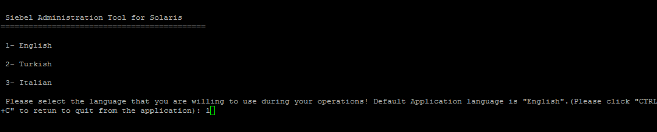
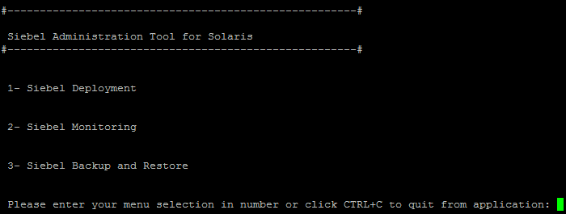
Executing the Siebel Administration Tool
Then please select a language to run the application menus, multi-language support is currently available only for menus; but whole tool can be translated in new languages other than English:
Main menu is displayed:

Slide 8
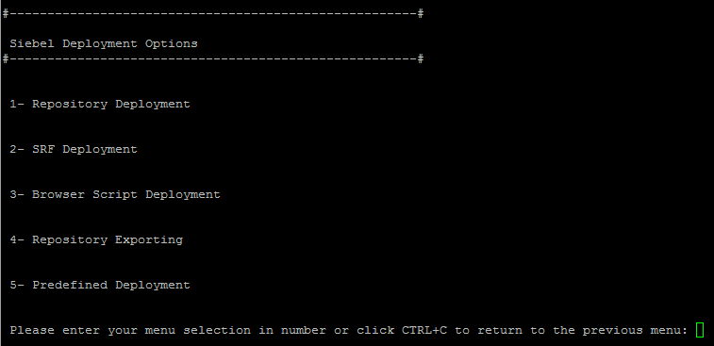
Siebel Deployment
Currently in v 0.2 only Predefined Deployment selection is not completed but all objects deployment is possible through other menus, please created and define a deployment package to run deployment:

Slide 9
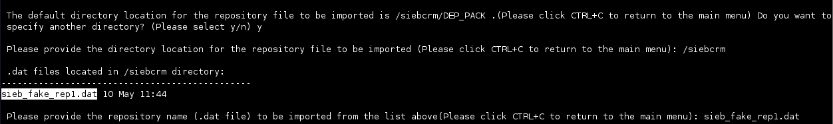
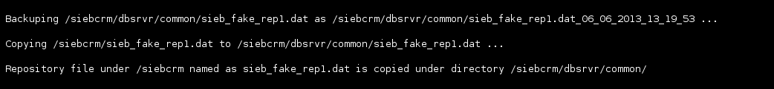
Repository Deployment
Tool displays default deployment package but allows a different package, then selectable .dat files are displayed.
Then all enterprise and GW Servers are shutdown (via auto login if RSA enabled in Unix Servers)
Old Repository is copied new repository copied to siebel db server directory

Slide 10
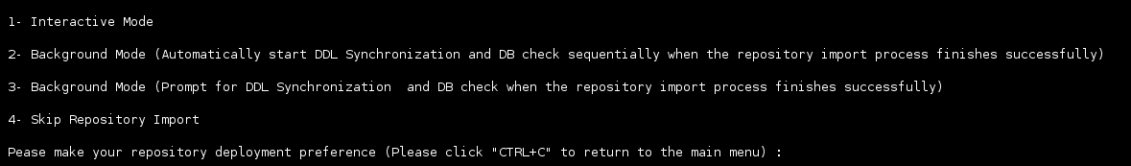
Repository Deployment
Then Repository Import, DDL Synch and DB Check can be done in the background or interactively. Moreover any step can be skipped in case the tool is closed after applying any of the steps.
Then all Enterprise and GW servers can be opened automatically (via auto login if RSA enabled in Unix Servers)
Finally you can exit; typing «exit»
After finishing you can check the logs available under <BASE DIRECTORY>/logs directory.

Slide 11
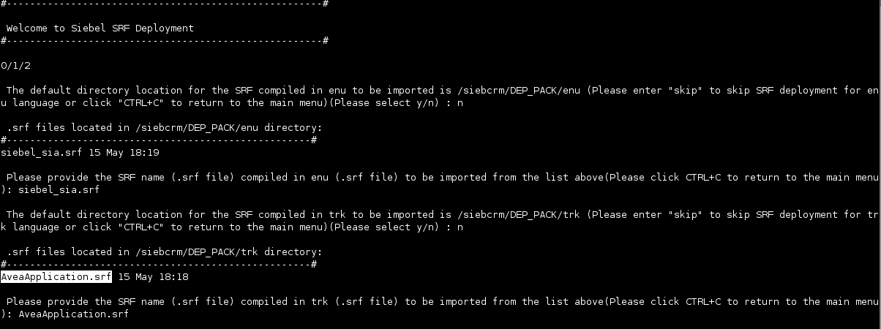
SRF Deployment
Tool displays default deployment package but allows a different package, then selectable and valid .srf files according to available siebel configuration files are displayed for each siebel application language. You can skip a language pack deployment.

Slide 12
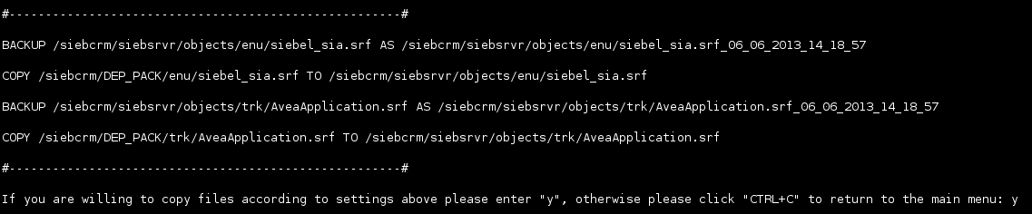
SRF Deployment
Then all Enterprise Servers are shutdown (via auto login if RSA enabled in Unix Servers)
After all enterprise servers are shutdown, a confirmation to control copying SRFs to the accurate Siebel Enterprise Server directories are prompted; after confirmed SRFs are copied.
After all SRFs are copied, a confirmation to generate Browser Scripts is prompted:
Finally you can exit; typing «exit»

Slide 13
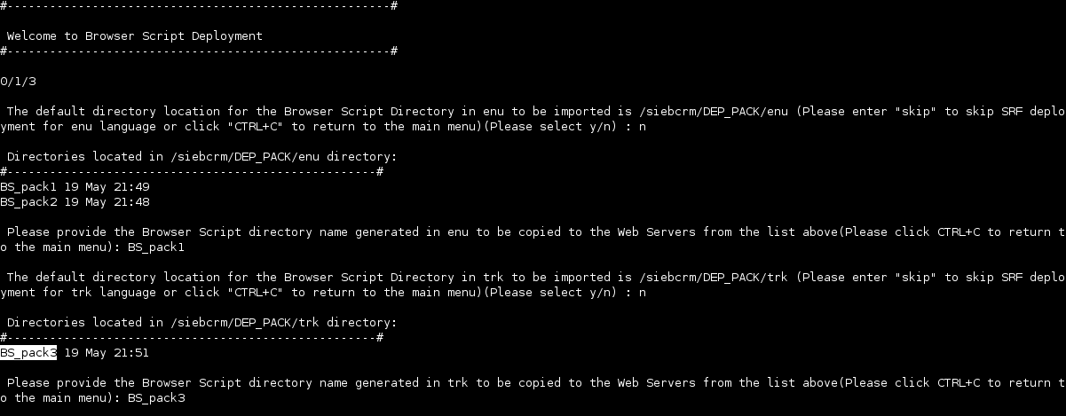
Browser Script Deployment
Tool displays default deployment package but allows a different package, then selectable browser script directories according to available siebel configuration files are displayed for each siebel application language. You can skip a language pack deployment.

Slide 14
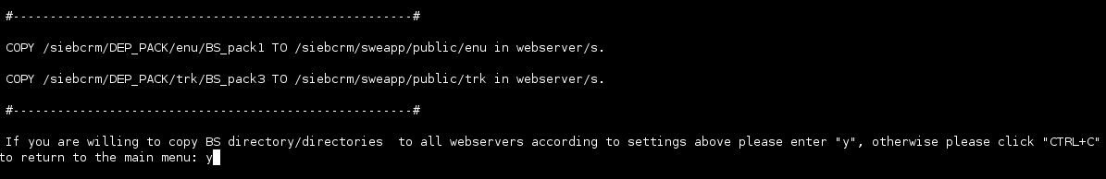
Browser Script Deployment
After all enterprise servers are shutdown, a confirmation to control copying Browser Scripts to the accurate Web Server directories are prompted; after confirmed Browser Scripts are copied.
Finally you can exit; typing «exit»

Slide 15
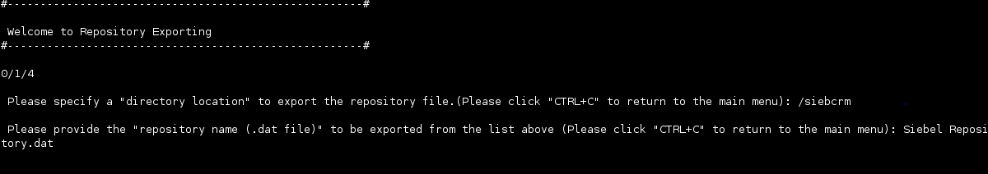
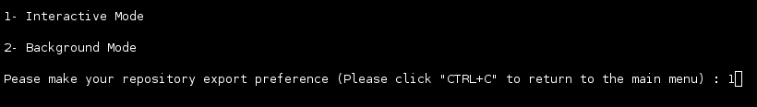
Repository Exporting
Specify the directory and file name to export a repository
Select whether repository export will be in background or interactive mode
Finally you can exit; typing «exit»

Slide 16
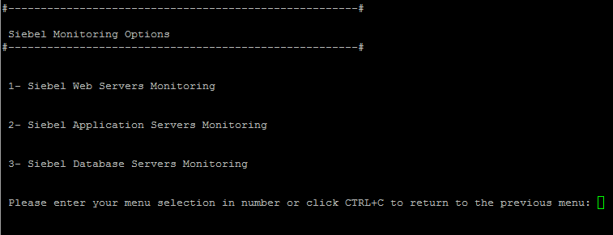
Monitoring
In Version 0.2 Only Siebel Application Server Monitoring function is as Enterpirse Server Monitoring available:

Slide 17
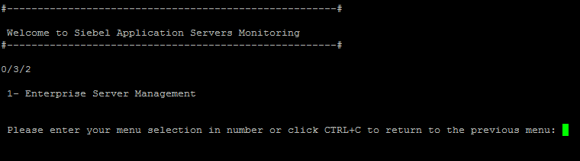
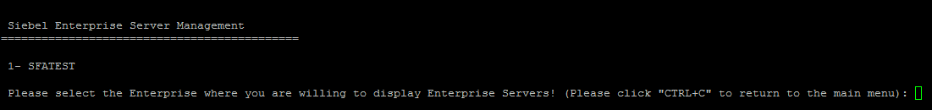
Enterprise Server Monitoring
In Version 0.2 Only Enterprise Server Monitoring with its components is available:
Select an Enterprise Server

Slide 18
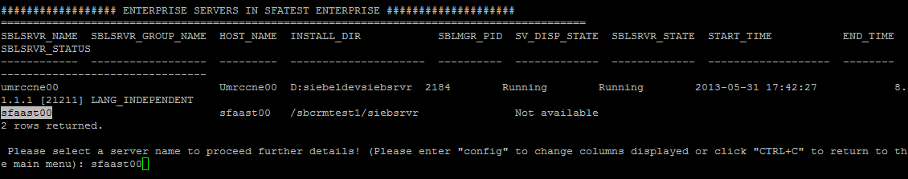
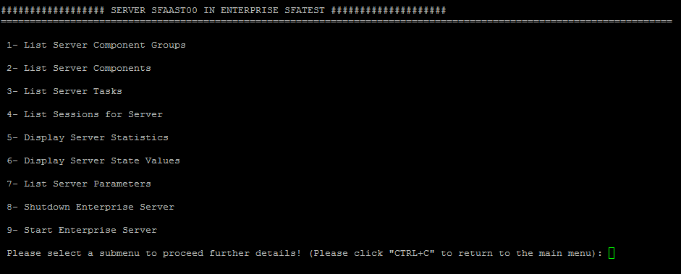
Enterprise Server Monitoring
Servers are for the selected enterprise are displayed, Select a Server Name:
Enterprise Server Management Options:

Slide 19
Enterprise Server Monitoring
Servers are for the selected enterprise are displayed, Select a Server Name:
Enterprise Server Management Options:

Slide 20
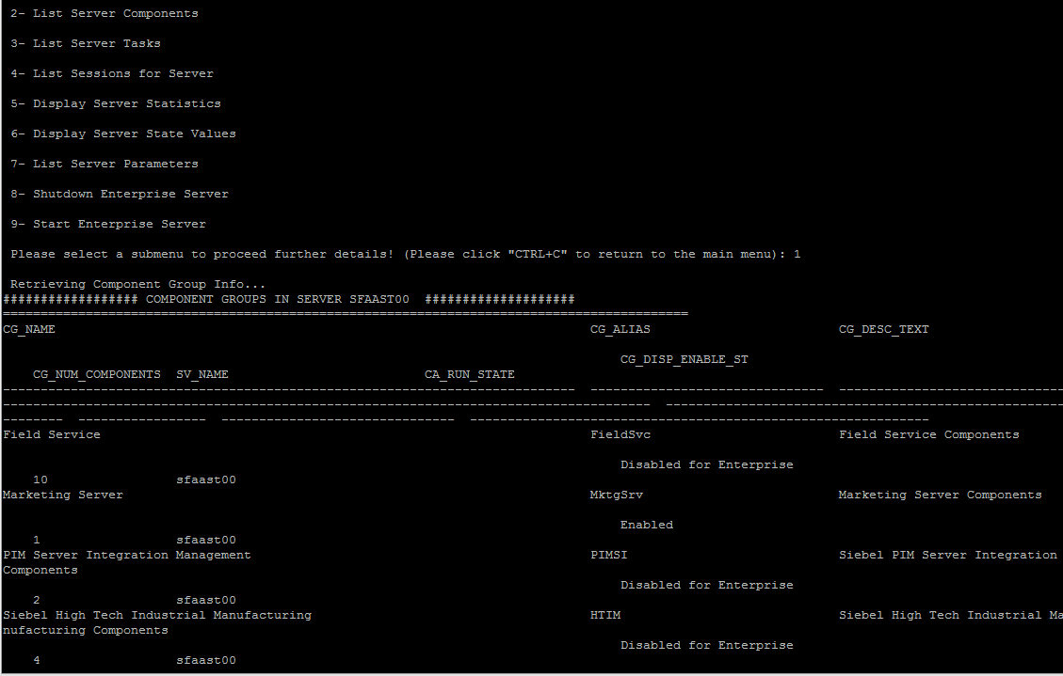
Enterprise Server Monitoring
For example component groups can be listed
Select a server component group alias

Slide 21
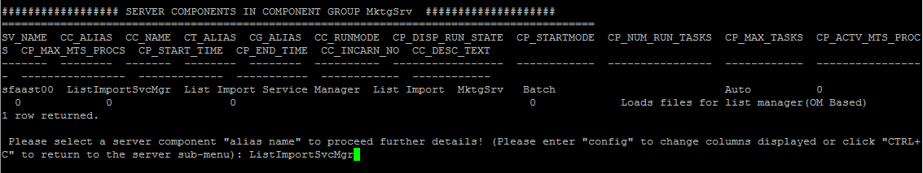
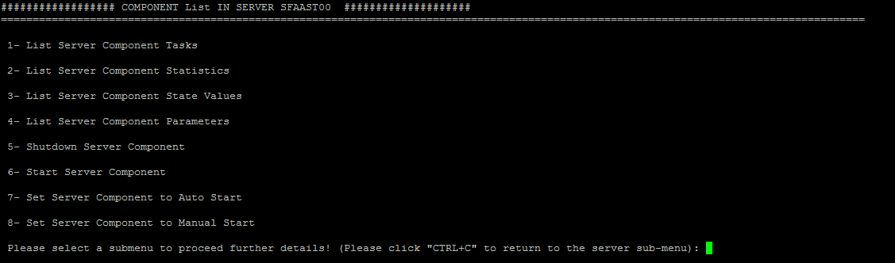
Enterprise Server Monitoring
Then components can be listed, select a component alias
Server component options are displayed

Slide 22
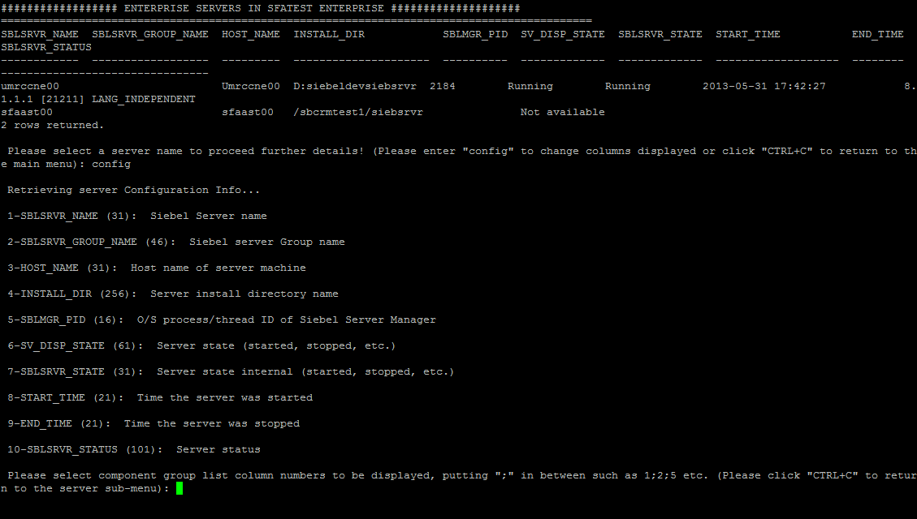
Enterprise Server Monitoring
You can also configure the columns displayed by typing «config»

Slide 23
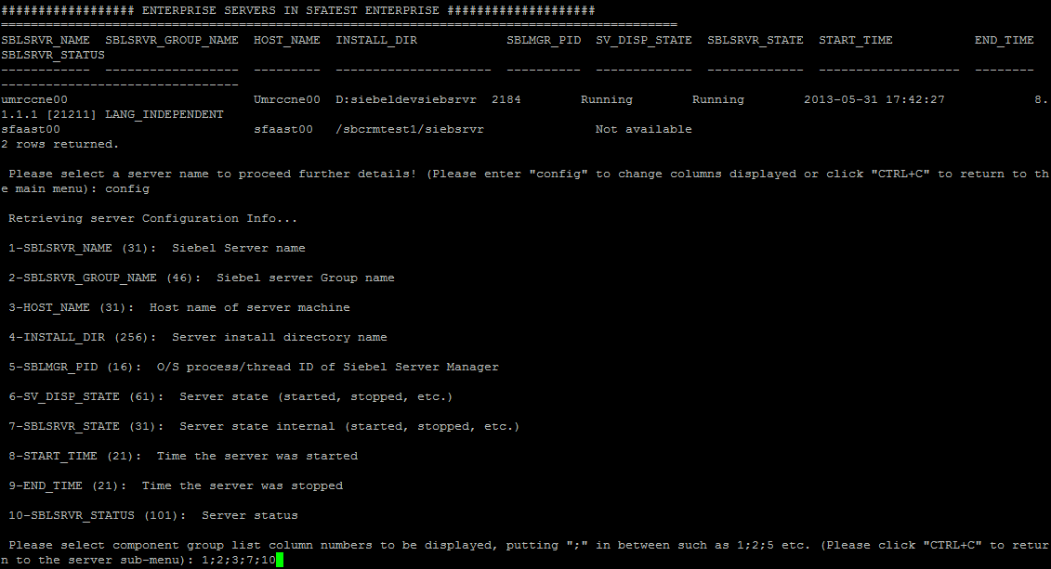
Enterprise Server Monitoring
Then select column numbers putting «;» in between (the list selection column is always mandatory)

Slide 24
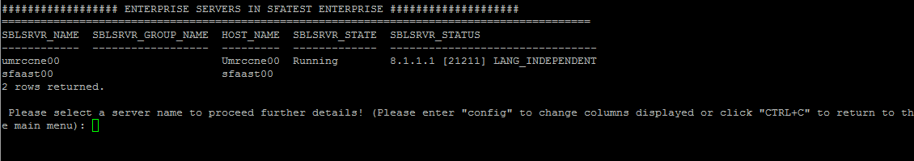
Enterprise Server Monitoring
Then only selected columns are displayed temporarily:

Slide 25
Q&A
Thank you!
Notes:
Horizontal split

